Slide 1
Pattern
Evaluation Methods

Slide 2
Which Patterns Are Interesting
Most association rule mining algorithms employ a support–confidence framework.
Although minimum support and confidence thresholds help weed out or exclude the exploration of a good number of uninteresting rules, many of the rules generated are still not interesting to the users.
Unfortunately, this is especially true when mining at low support thresholds or mining for long patterns.
This has been a major bottleneck for successful application of association rule mining.

Slide 3
Strong Rules Are Not Necessarily Interesting
Whether or not a rule is interesting can be assessed either subjectively or objectively.
Ultimately, only the user can judge if a given rule is interesting, and this judgment, being subjective, may differ from one user to another.

Slide 4
A misleading “strong” association rule.
Suppose we are interested in analyzing transactions at AllElectronics with respect to the purchase of computer games and videos.
Let game refer to the transactions containing computer games, and video refer to those containing videos.
Of the 10,000 transactions analyzed, the data show that 6000 of the customer transactions included computer games, while 7500 included videos, and 4000 included both computer games and videos.

Slide 5

Suppose that a data mining program for discovering association rules is run on the data
using a minimum support of, say, 30%
and a minimum confidence of 60%.
The following association rule is discovered:

Slide 6
Rule is a strong association rule and would therefore be reported, since
its support value of 4000/10,000 = 40% and confidence value of 4000/6000 = 66% satisfy the minimum support and minimum confidence thresholds, respectively.
However, this Rule is misleading
because the probability of purchasing videos is 75%, which is even larger than 66%.
In fact, computer games and videos are negatively associated because
the purchase of one of these items actually decreases the likelihood of purchasing the other.
Without fully understanding this phenomenon, we could easily make unwise business decisions based on this Rule.

Slide 7
confidence of a rule A ⇒ B can be deceiving.
It does not measure the real strength (or lack of strength) of the correlation and implication between A and B.

Slide 8
From Association Analysis to Correlation Analysis
To tackle this weakness,
a correlation measure can be used
to augment the support–confidence framework for association rules.
This leads to correlation rules of the form

Slide 9
That is, a correlation rule is measured not only by its support and confidence but also by the correlation between itemsets A and B.
There are many different correlation measures
Lets see several correlation measures to determine which would be good for mining large data sets.

Slide 10
A Simple correlation measure
Lift
The occurrence of itemset A is independent of the occurrence of itemset B if
P(A∪B) = P(A)P(B); otherwise,
itemsets A and B are dependent and correlated as events.
This definition can easily be extended to more than two itemsets.

Slide 11

The lift between the occurrence of A and B can be measured by computing
If the resulting value of Eq. is less than 1, then
the occurrence of A is negatively correlated with the occurrence of B, meaning that the occurrence of one likely leads to the absence of the other one.
If the resulting value is greater than 1, then
A and B are positively correlated, meaning that the occurrence of one implies the occurrence of the other.
If the resulting value is equal to 1, then
A and B are independent and there is no correlation between them.

Slide 12
Lift is equivalent to P(B|A)/P(B), or conf(A ⇒ B)/sup(B), which is also referred to as the lift of the association (or correlation) rule A ⇒ B.
In other words, it assesses the degree to which the occurrence of one “lifts” the occurrence of the other.
For example, if A corresponds to the sale of computer games and B corresponds to the sale of videos, then given the current market conditions,
the sale of games is said to increase or “lift” the likelihood of the sale of videos by a factor of the value returned by above Eq (Lift)

Slide 13
Let’s go back to the computer game and video data
Correlation analysis using lift.
To help filter out misleading “strong” associations of the form A ⇒ B from the data of earlier Example, we need to study how the two itemsets, A and B, are correlated.
The transactions can be summarized in a contingency table

Slide 14
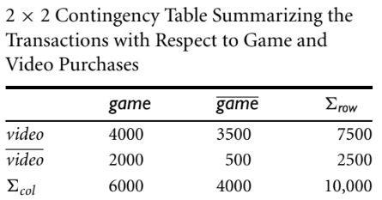

Slide 15
From the table, we can see that
the probability of purchasing a computer game is P({game}) = 0.60,
the probability of purchasing a video is P({video}) = 0.75, and
the probability of purchasing both is P({game, video}) = 0.40.
the lift of Rule (6.6) is P({game, video})/(P({game}) × P({video})) = 0.40/(0.60 × 0.75) = 0.89.
Because this value is less than 1
there is a negative correlation between the occurrence of {game} and {video}.

Slide 16
Lift
The numerator is the likelihood of a customer purchasing both, while
the denominator is what the likelihood would have been if the two purchases were completely independent.
Such a negative correlation cannot be identified by a support–confidence framework.

Slide 17
The second correlation measure- χ2 measure
To compute the χ2 value,
we take the squared difference between the observed and expected value for a slot (A and B pair) in the contingency table, divided by the expected value.
This amount is summed for all slots of the contingency table.

Slide 18
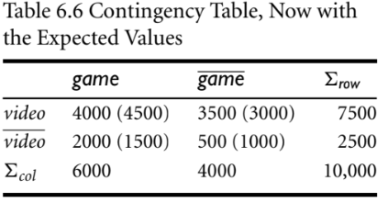
Let’s perform a χ2 analysis of previous Example

Slide 19
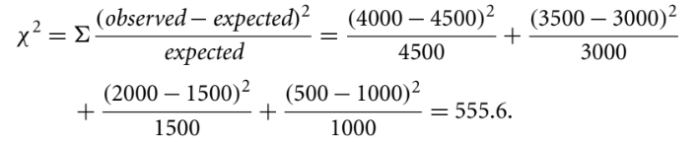
Correlation analysis using χ2
To compute the correlation using χ2 analysis for nominal data,
we need the observed value and expected value (displayed in parenthesis) for each slot of the contingency table
From the table, we can compute the χ2 value as follows:

Slide 20
Because the χ2 value is greater than 1, and the observed value of the slot (game, video) = 4000, which is less than the expected value of 4500, buying game and buying video are negatively correlated.
This is consistent with the conclusion derived from the analysis of the lift measure.

Slide 21
Several other pattern evaluation measures have attracted interest.
four such measures:
all confidence,
max confidence,
Kulczynski, and
cosine.

Slide 22

All confidence measure
Given two itemsets, A and B, the all confidence measure of A and B is defined as
where max{sup(A), sup(B)} is the maximum support of the itemsets A and B.
Thus, all_conf(A,B) is also the minimum confidence of the two association rules related to A and B, namely, “A ⇒ B” and “B ⇒ A.”

Slide 23
max confidence measure
Given two itemsets, A and B, the max confidence measure of A and B is defined as
max conf(A, B) = max{P(A|B),P(B|A)}.
The max conf measure is the maximum confidence of the two association rules,
“A ⇒ B” and “B ⇒ A.”

Slide 24

Kulczynski measure
It was proposed in 1927 by Polish mathematician S. Kulczynski.
It can be viewed as an average of two confidence measures.
That is, it is the average of two conditional probabilities
the probability of itemset B given itemset A, and the probability of itemset A given itemset B.
Given two itemsets, A and B, the Kulczynski measure of A and B (abbreviated as Kulc) is defined as

Slide 25
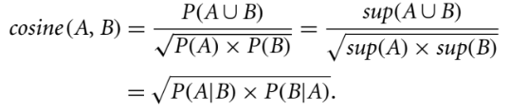
Cosine measure
Finally, given two itemsets, A and B, the cosine measure of A and B is defined as
The cosine measure can be viewed as a harmonized lift measure
The two formulae are similar except that for cosine, the square root is taken on the product of the probabilities of A and B.
This is an important difference, however, because by taking the square root, the cosine value is only influenced by the supports of A, B, and A ∪B, and not by the total number of transactions.

Slide 26
Properties of above four measures
Its value is only influenced by the supports of A, B, and A ∪B, or more exactly, by the conditional probabilities of P(A|B) and P(B|A), but not by the total number of transactions.
Another common property is that each measure ranges from 0 to 1, and the higher the value, the closer the relationship between A and B.

